Slide 1
Objectives this evening
• To share parking survey results.
• To answer questions
• To hear your views

Slide 2
Proposal for Kinnerley Parish Council’s Decision
• KPC to retain ownership of the land – only leasing or licensing the part needed by the developers.
• Developer to meet all construction & maintenance costs.
• If the shop ceases trading, this agreement will end.

Slide 3
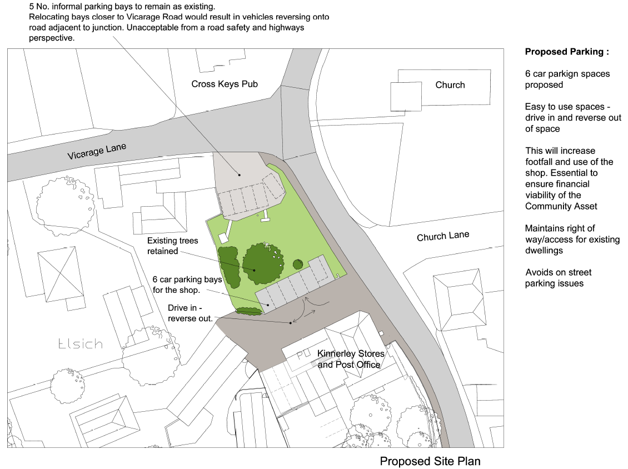
The Proposal

Slide 4
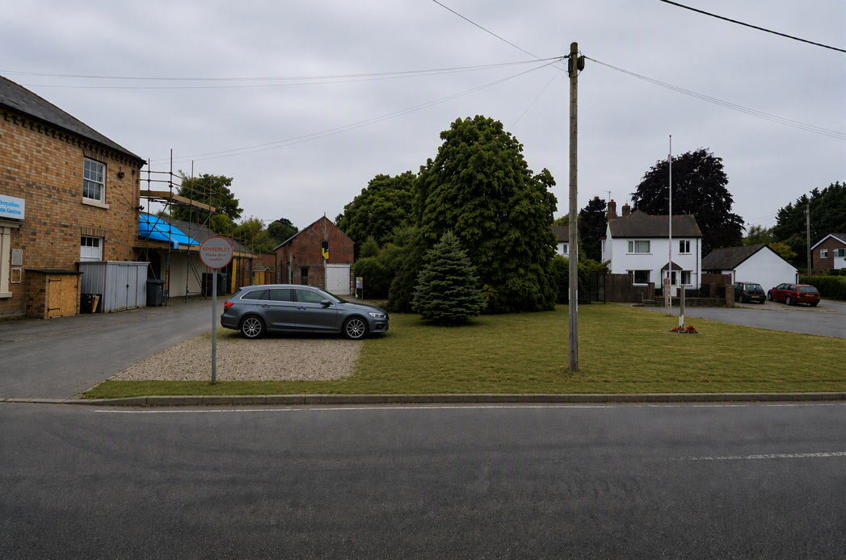
The Proposal

Slide 5
Q1: Where Do You Live?
• 46% – in Kinnerley village (122 responses)
• 47% – elsewhere in our Parish (126 responses)
• 7% – outside the Parish (18 responses)
Total responses: 266

Slide 6
Q2: How often do you use the Shop?
• 41% – several times a week (109 responses)
• 39% – about once a week (103 responses)
• 15% – about once a month (41 responses)
• 5% – less often or never (Used to: 2%, About once a year: 3%, Never: 0%)
Total responses: 266

Slide 7
Q3: Do you drive to the Shop?
• 69% – YES, usually drive (183 responses)
• 31% – NO, do not drive (81 responses)
Total responses: 264

Slide 8
Q4: If Yes, where do you usually park?
• 41% – In the parking area outside the shop (87 responses)
• 35% – In the tarmacked parking area (75 responses)
• 19% – It varies (40 responses)
• 4% – Road (3%) or Church Lane (1%)
Based on 212 car users

Slide 9
Q5: Importance of the Village Shop
• 98% – Important (85%) or Very Important (13%)
• 2% – Neutral (5 responses)
• 0% – Not important at all (no responses)
Total responses: 267

Slide 10
Q6: Importance of the Village Green
• 68% – Important (34%) or Very Important (34%)
• 21% – Neutral (57 responses)
• 12% – Not very (9%) / Not at all (3%)
Total responses: 267

Slide 11
Q7: Is there a parking problem at the Shop?
• 58% – Yes (154 responses)
• 29% – No (77 responses)
• 13% – Unsure (33 responses)
Total responses: 264

Slide 12
Q8: Is Shop parking an issue for you?
35% - Never (87 responses)
• 46% – Sometimes (116 responses)
• 13% – Usually (32 responses)
• 6% – Always (16 responses)
Total responses: 251

Slide 13
Q9: Benefit of increasing shop parking?
• 45% – Very beneficial (120 responses)
• 26% – Somewhat beneficial (68 responses)
• 26% – No significant benefit (68 responses)
• 3% – Unsure (8 responses)
Total responses: 264

Slide 14
Q10: Support Using Part of VG for Shop Parking?
• 62% – Support (34%) or Strongly support (28%)
• 30% – Oppose (17%) or Strongly Oppose (13%)
• 8% – Neutral (20 responses)
Total responses: 265

Slide 15
Q11: Impact on Village Character?
• 41% – Negative impact (18% major/23% some impact)
• 36% – Little impact (91 responses)
• 14% – No impact (35 responses)
• 9% – Positive impact (24 responses)
Total responses: 255

Slide 16
Q12: Support extending other end of Village Green?
• 42% – Oppose (18%) or Strongly Oppose (24%)
• 32% – Strongly support (17%) or Support (15%)
• 25% – Neutral (66 responses)
Total responses: 260

Slide 17
Q13: Core Priority View
• 70% – Supporting Village Shop (175 responses)
• 18% – Preserving Village Green (45 responses)
• 12% – No preference (31 responses)
Total responses: 251

Slide 18
Q14: Preferences in rank order
Parish Council to best protect shop’s future but preserve Village Green
Allow part of Village Green for parking.
Part of Village Green for parking with balancing land.
Leave all parking arrangements untouched.
Village Green unchanged & no parking changes

Slide 19
Q&A Session
Please, now, use this opportunity to share your thoughts, questions, and comments.
And thank you for joining us this evening!

